Slide 1
Introduction to LangChain AI Agents for Building Intelligent AI Applications

Slide 2
Course Objectives
Understand LangChain's architecture and how it enables AI workflows.
Build chains, prompts, memory-based applications and agents.
Learn how to integrate external tools and knowledge sources.
Explore Retrieval-Augmented Generation (RAG) and implement knowledge-backed applications.
Apply best practices for building secure, scalable and robust AI solutions.

Slide 3
Installations and required setup to use langchain
Install LangChain and its integrations
Core framework:
pip install langchain
Integrations you’ll likely need:
pip install langchain-community
pip install langchain-openai
pip install langchain-core
install VS Code, python and pip on your machine
Create python virtual environment
(venv)
Set your API keys as environment variables pip install python-dotenv
py -m venv .venv
.venv\Scripts\Activate
Create .env in the working directory and enter your APIkey, OPENAI_API_KEY: “sk-…”
Refer this official documentation from langchain
https://python.langchain.com/docs/introduction/

Slide 4
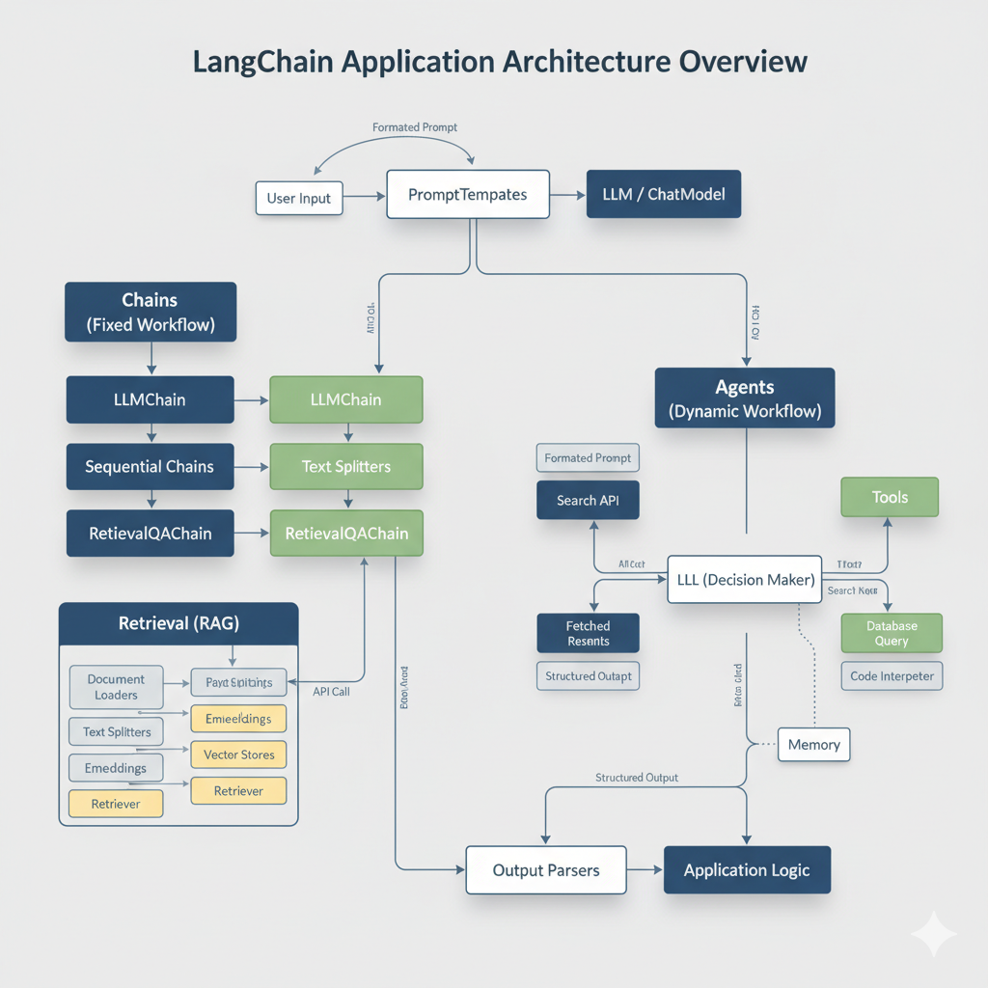
Architecture of langchain

Slide 5
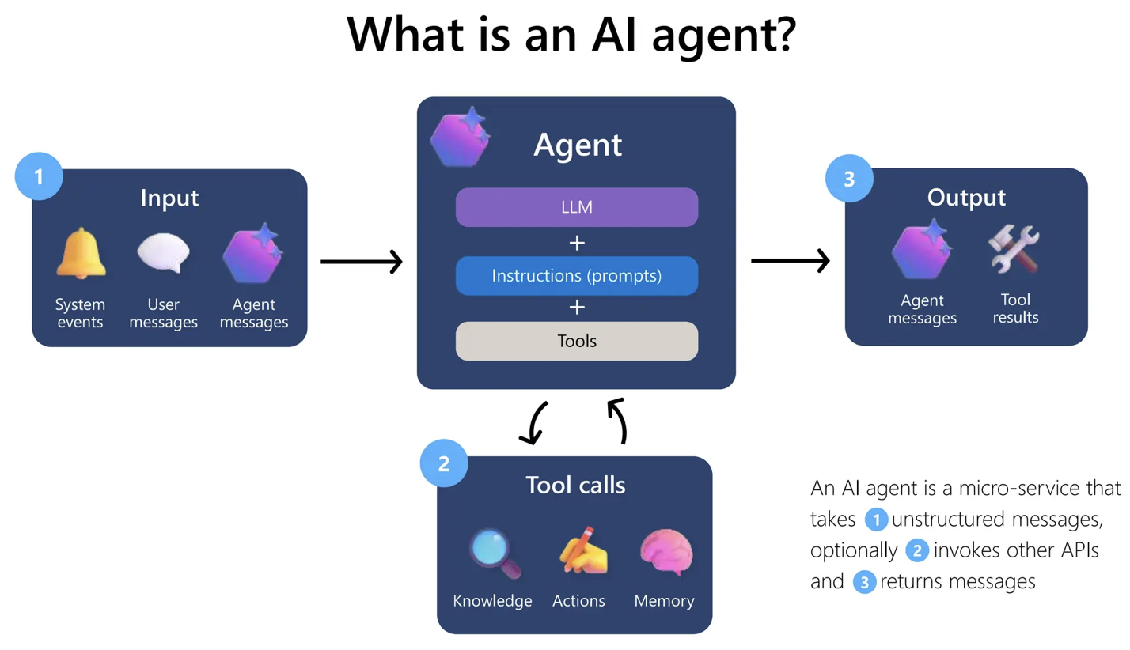

Slide 6
Agents
Agents are dynamic chains that use an LLM to decide which actions to take and in what order. Instead of a fixed sequence of steps, an agent observes its environment, reasons, acts and repeats until it achieves its goal.
For example, an Agent might:
Call a weather API to fetch the current temperature.
Run a Python script to perform data analysis.
Search a knowledge base to retrieve a specific document.

Slide 7
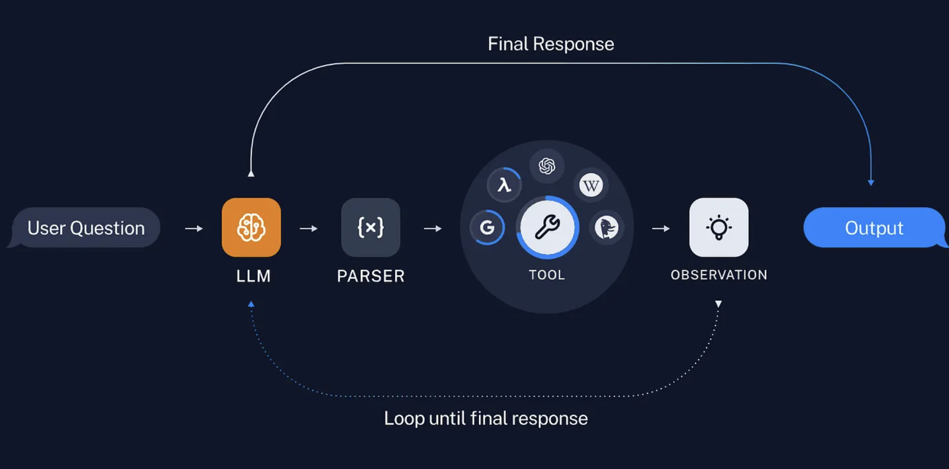
How Langchain Agents work
Agents typically operate in a loop:
Receive user input.
Decide which tools to use.
Execute the tool and retrieve results.
Generate a response based on the output.

Slide 8
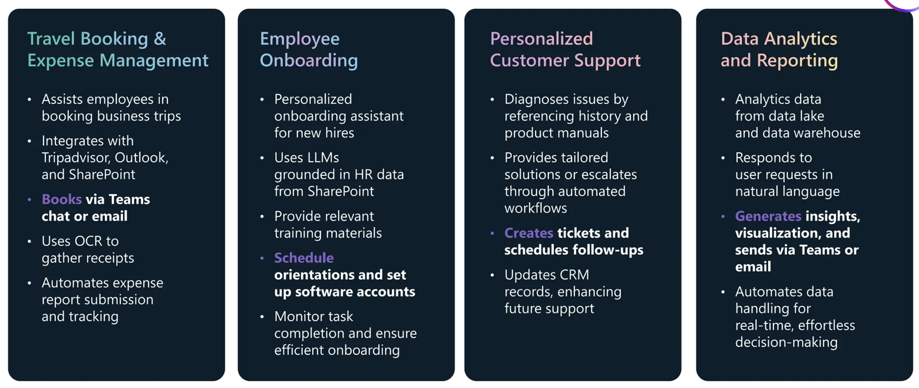
AI Agents use cases
Agent = Tools + Memory
Unlike previous tools, AI agents can reason, act and learn

Slide 9


Langchain
﻿﻿Framework for building LLM Applications
﻿﻿Focus on retrieving data and integrating with LLMs
Integrations with most Al popular tools
LangGraph by Langchain
﻿﻿Build Stateful apps with LLMs and Multi-Agents workflow
Cycles and Branching
﻿﻿Human-in-the-Loop
Persistence

Slide 10
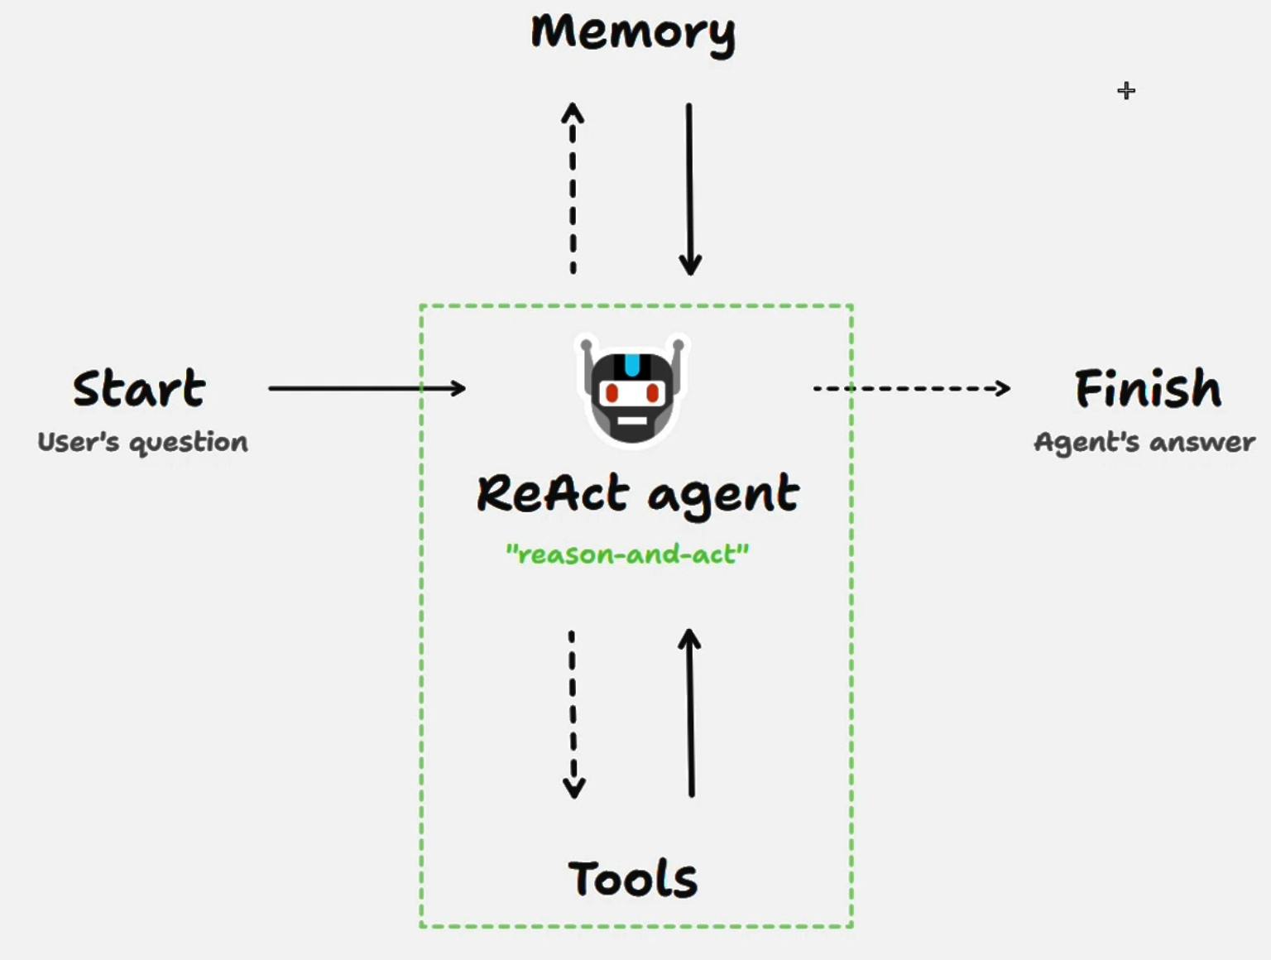
Architecture User Input → Prompt → Agent → Tool Invocation → API Response → Output Parser → Final Response

Slide 11
Agents and Decision Making: The LLM as a Controller
Architecture:
Agent: Comprises an LLM (brain), a set of Tools (actions), and a AgentType (the reasoning loop, e.g., ReAct)
2.AgentExecutor: The runtime that orchestrates the agent's cycle:
Thought
Action
Observation
Loop
Routing: The LLM's primary role in an Agent is to route the query to the appropriate tool. Its prompt guides it to reason about tool descriptions.
Fallback Logic: Can be built into the agent's reasoning prompt

Slide 12
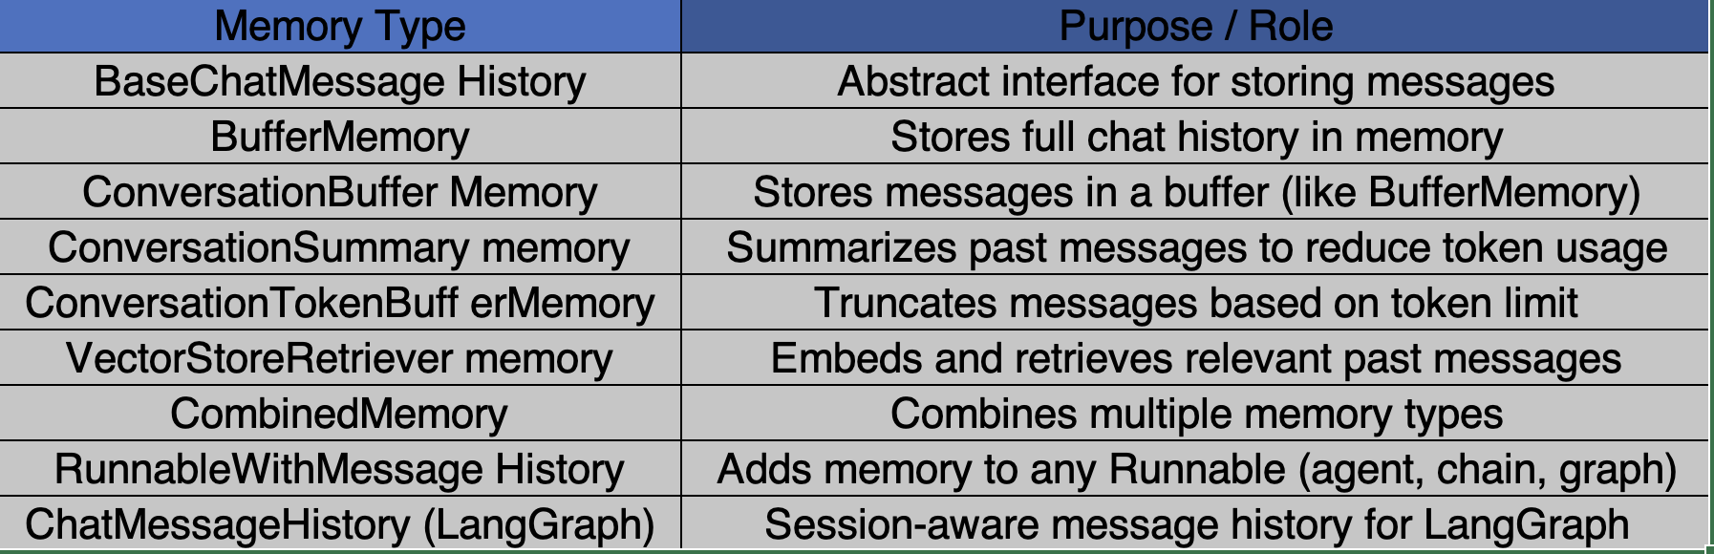
Memory in langchain
Memory lets an LLM keep track of the conversation and past context across turns, enabling smooth, connected interactions.
Implementing Context-Awareness in Apps:
Architecture:
A Memory object is initialized and passed into a Chain or Agent.
The Memory automatically manages adding new messages and retrieving past ones.
PromptTemplates are designed to include a chat_history variable that the Memory populates.

Slide 13
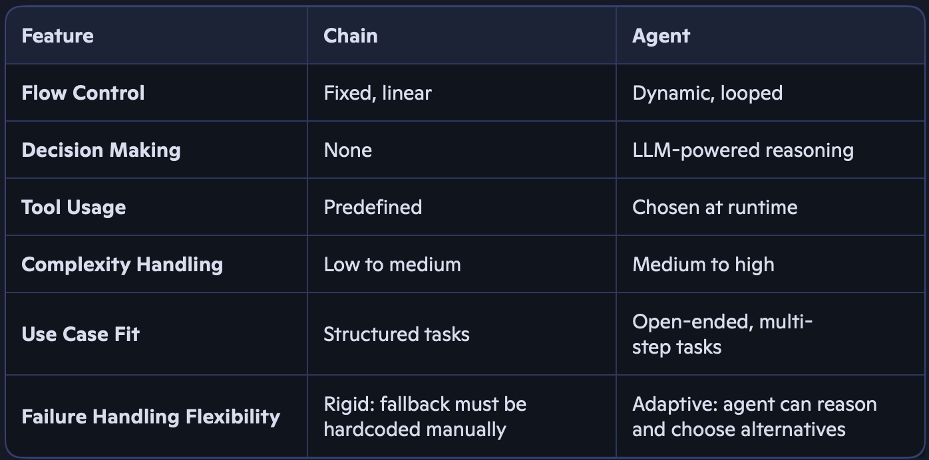
Difference between chain & Agents
Chains: It is used to build pipeline in LLMs. Chains are more predictable and easier to debug, but less adaptable when input or requirements change.
Agents: It has reasoning capabilities and access to Tools which helps AI Agents to do a task

Slide 14
Debugging and Error Handling
Toolcall can encounter issues due to tool misuse by the LLM or misaligned input expectations..
Why Toolcalling errors occur: Call Nonexistent Tools, Misuse Arguments, Lack Context
How to handle:
1) Built-in Error Handling with ToolNode:ToolNode in LangGraph automatically captures tool errors and reports to the model
2) Enhancing Error Handling with Custom Logic: Default error handling might not always be sufficient. Custom fallback strategies can be implemented to improve the agent’s robustness.
Monitoring Interactions:
Callbacks: LangChain provides a callback system that allows you to hook into various events (on_llm_start, on_tool_end, on_chain_error, etc.).
Logging: Using standard Python logging to record intermediate steps, inputs, outputs, and tool calls.
Tracing Tools: Integrations with tools like LangSmith
Handling Failures and Retries:
Tool-level Retries
Agent-level Fallbacks
Try/Except Blocks
Circuit Breakers

Slide 15
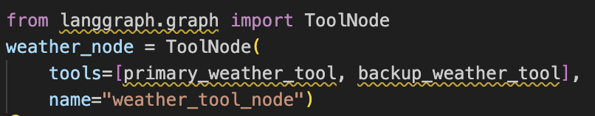
🔁 Fallback Mechanisms
ToolNode supports fallbacks in two main ways:
1. Multiple Tool Candidates
• If you register multiple tools under a ToolNode, it can try alternatives if the first one fails.
• Example: If search_weather_api fails, fallback to backup_weather_api.
2. Retry Logic
• You can implement retry strategies using LangGraph’s control flow.
• ToolNode makes it easy to plug this in without rewriting tool logic.
If primary_weather_tool fails (e.g., API down), ToolNode can automatically try backup_weather_tool or return a structured error that the agent can handle.

Slide 16
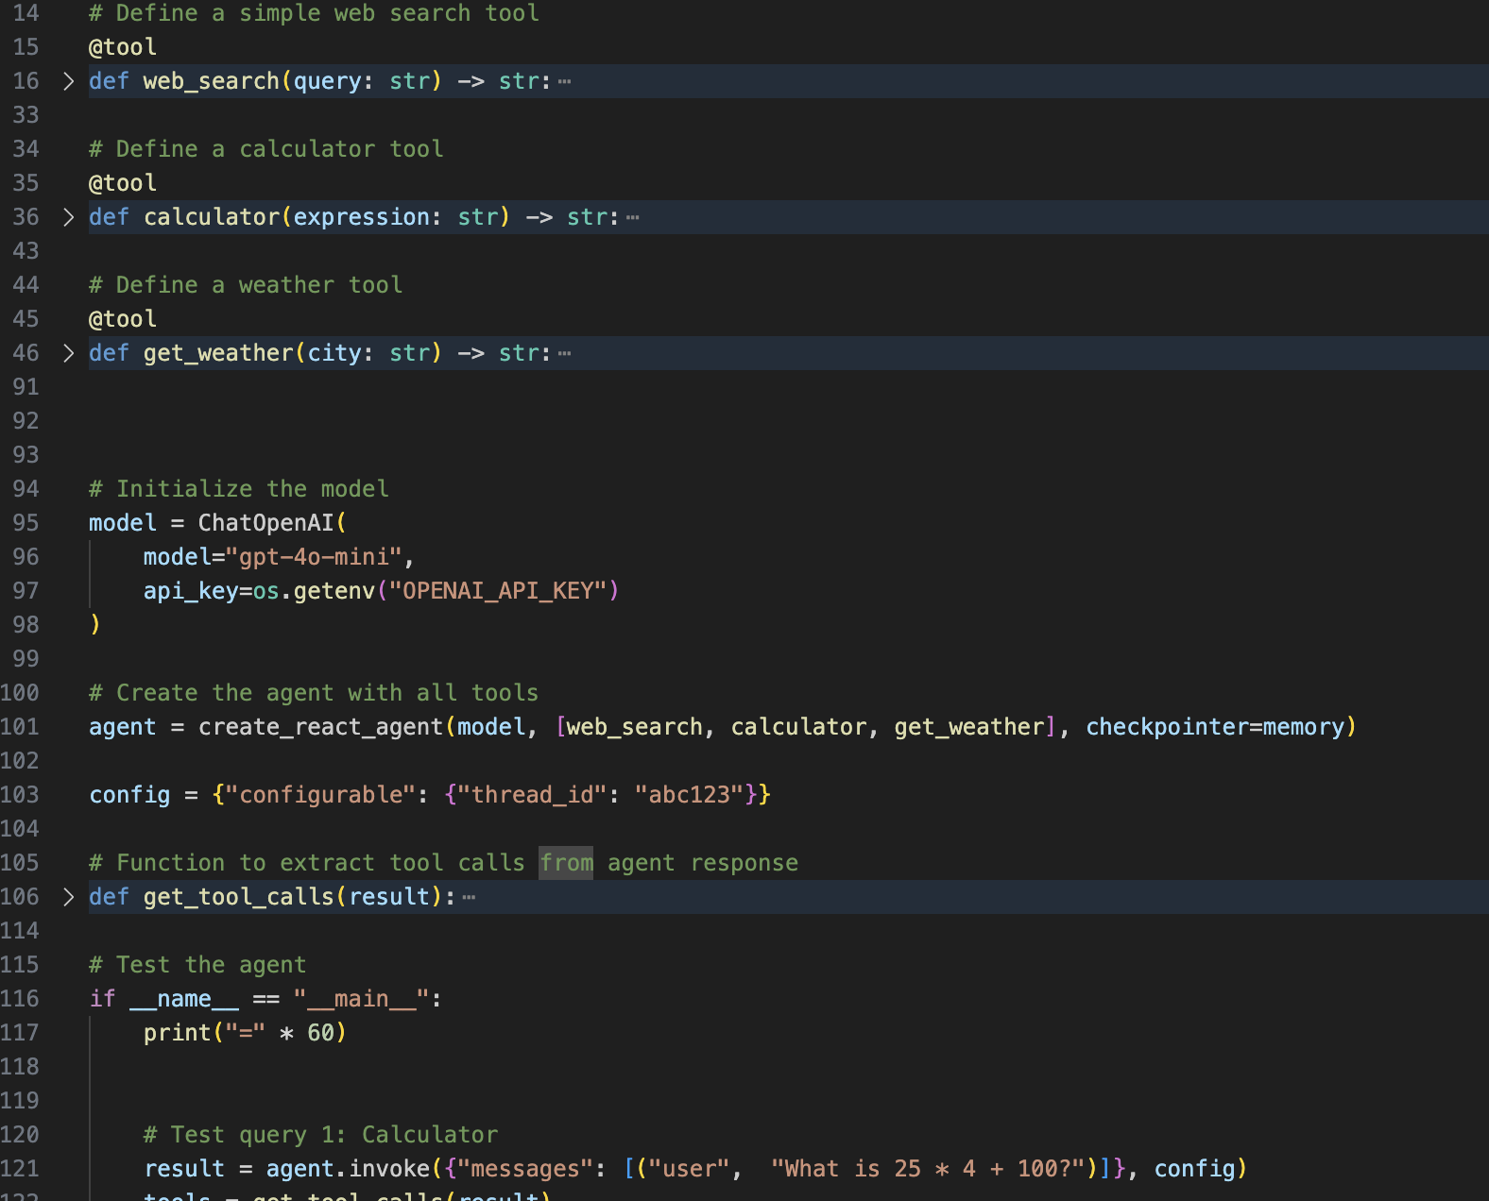
Hands on
Create an Agent with Tool Selection

Slide 17
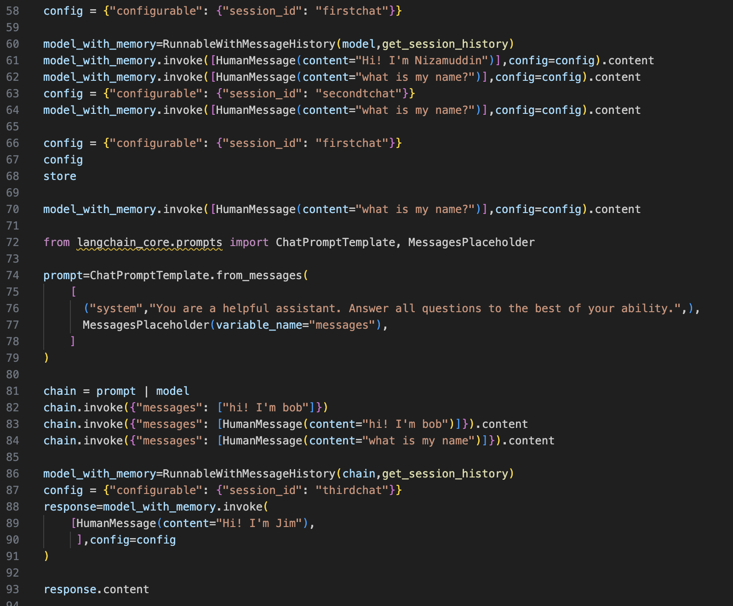
Hands on
Create a chatbot with memory

